Slide 1
Leveraging Log Analytics in Custom Applications
Global Azure Bootcamp 2019
Alex Chance
Solutions Architect
Coleman Worldwide Moving

Slide 2


How do you manage your logs?

Slide 3
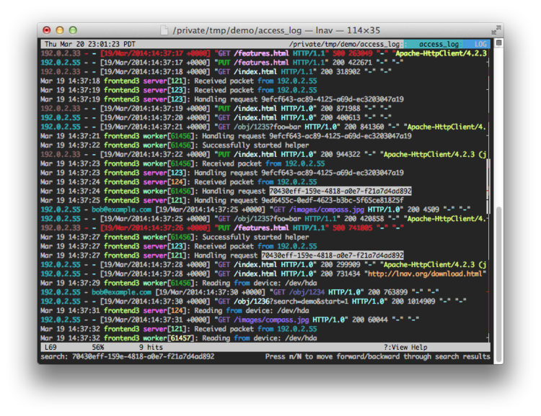
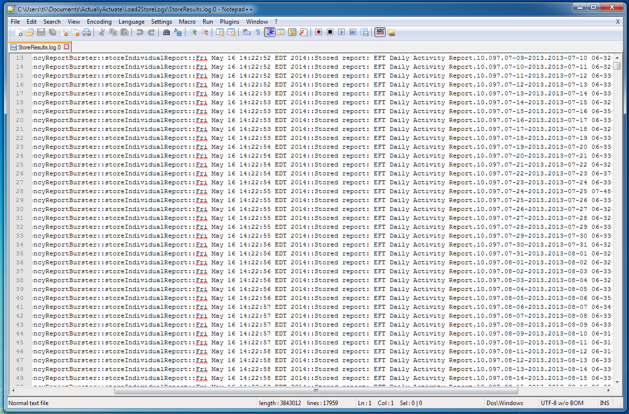
Not those logs, these logs:

Slide 4
Common Log Practices
No Logs at all (You probably know THAT guy)
Log to a text file locally
Can be painful to monitor
Custom log database
May require a lot to implement and maintain
Logs as a Service/Centralized Logging
Cloud services, such as Logz.io
Depending on needs these can be pricy and difficult to setup

Slide 5
Azure Log Analytics
Azure provides several tools under Azure Monitor
Azure Log Analytics / Azure Monitor Logs
Can collect logs from a variety of sources
Provides a Data Collector API which can be used with any other source
Built-in robust alerting
Flexible for many different data types
Cost-effective, especially for customers already using other Azure services
Notes:
Azure is changing terminology to Azure Monitor Logs. You may also see Azure Monitor referred to as Azure OMS.

Slide 6
Demo
Go to the GitHub repo at:
https://github.com/achance/GAB19

